Slide 1
NTE 1010
Introduction to
Finance
for Engineers
Spring
2020
Review

Slide 2
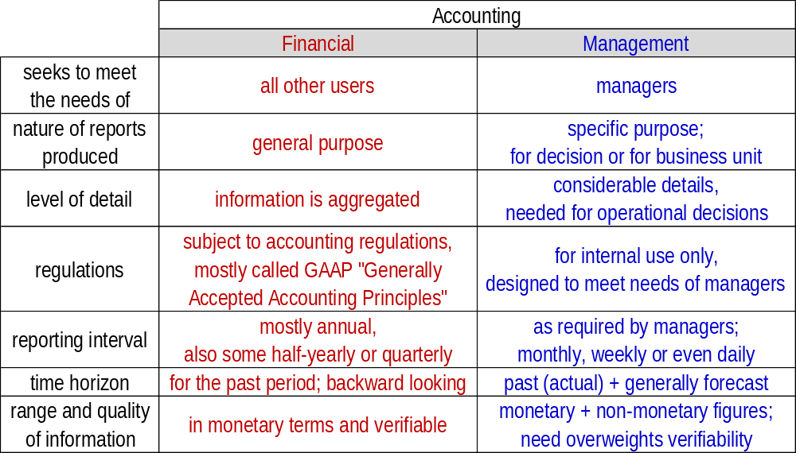
NTE 1010 – Introduction to Finance for Engineers
[1] Financial Accounting
Accounting vs Finance
  Accounting is concerned with
  collecting, analysing and communicating financial information.
  Finance is concerned with
  the ways in which funds for a business are raised and invested.
  Financial Accounting versus Management Accounting

Slide 3
NTE 1010 – Introduction to Finance for Engineers
[1] Financial Accounting
Accounting Principles and Conventions
  Each country has a different variation of ″Generally Accepted Accounting Principles″.
  For example, GAAP accepted in Turkey are called TR GAAP, in USA as US GAAP.
  A version that is harmonized internationaly is called IFRS,
  ″International Financial Reporting Standards″.
  Although it is not necessary to have a detailed understanding of GAAP or IFRS
  in order to understand the financial statements,
  it is necessary to understand
  some of the basic accounting principles and conventions:
  Business Entity
  The business and its owners are treated separately for the purposes of accounting;
  this differs from the legal treatment.
  Accrual Accounting
  Historical Cost

Slide 4
NTE 1010 – Introduction to Finance for Engineers
[1] Financial Accounting
Business Entity
  The business and its owners are treated separately for the purposes of accounting;
  this differs from the legal treatment.
  The three main forms of legal structures of a business are
  Sole propriertorship (şahıs şirketi)
  where owner is personally responsible for the debts of the business,
  Partnership (adi ortaklık)
  where partners are ″jointly and severally responsible″
  meaning that creditors can attempt to recover bad debts
  from all the owners, or each one separately, in their personal capacities,
  Corporation (şirket)
  where the most that the owners can lose is their equity investment in the company.

Slide 5
NTE 1010 – Introduction to Finance for Engineers
[1] Financial Accounting
Accrual Accounting
  Accrual accounting recognises a sale when it occurs, that is, when the sale documents are signed, not when the customer finally pays the cash in settlement.
  If the transaction occurs before the cash transfer, the transaction is accrued,
  and if the transaction is recognised after the cash transfer, it is deferred.
  For example, deferred taxation is the recognition of taxes owed but not paid yet.
  Because of the difference in timing between the recognition of a transaction and cash receipt or payment, there is the need to match the expenses to the correct period in which the revenue is recognised. Matching expenses and revenues allows for
  the correct calculation of the profit that a company has made in a particular period.
  On the other hand, the cost of an asset with a useful life of longer than a year
  is spread out over its expected useful life.
  This procedure is called depreciation.

Slide 6
NTE 1010 – Introduction to Finance for Engineers
[1] Financial Accounting
Historical Cost
  The figures in the accounts represent historical values,
  i.e. the cost of acquiring the assets or goods at the date of acquisition.
  The value of an asset in the accounts, that is, its ″book value″ is unrelated to its value
  either within the business (replacement value) or to its value to others (market value).
  Although this seems unrealistic, historical cost reporting removes the requirement
  for valuation based on subjective opinion,
  which could result in manipulation of the financial position.
  This convention also removes the need to adjust the figures for inflation.
  Nevertheless, in high inflation environments (where cumulative inflation rate over three years exceeds 100%), ″inflationary accounting″ is allowed.
  This is also in accord with the conservative position adopted by accounting. For example, if losses are probable, and can be reasonably estimated, they are recorded. However, if gains ocur, these are only recorded when they occur.

Slide 7
NTE 1010.1 – Introduction to Finance for Engineers
[1] Financial Accounting
Accounting Conventions
  Money Measurement
  Resources not capable of being measured in monetary terms will be excluded. Accounting normally deals with only those items that are capable of being expressed in monetary terms. Money has the advantage that it is a useful common denominator with which to express the wide variety of resources held by a business.
  Going Concern
  Financial statements are to be prepared on the assumption that the business will continue operations for the foreseeable future, unless this is known not to be true. In other words, it is assumed that there is no intention, or need, to sell off the non-current assets of the business. Based on this assumption, it is prudent to continue to show the value of non-current assets at their recorded values (that is, based on historic cost).
  Dual Aspect
  Each transaction has two aspects, both of which will affect the balance sheet. The purchase of a car for cash results in an increase in one asset (vehicles) and a decrease in another (cash). The repayment of a bank loan results in the decrease in a liability (loans) and the decrease in an asset (cash / bank).
  Prudence
  Financial statements should err on the side of caution. The convention represents an attempt to deal with the uncertainty surrounding many events reported in the financial statements, and evolved to counteract the excessive optimism of some managers and owners, which resulted in an overstatement of financial position.
  Objectivity
  Objectivity convention seeks to reduce personal bias in financial statements. Financial statements should be based on objective verifiable evidence rather than on matters of opinion.

Slide 8
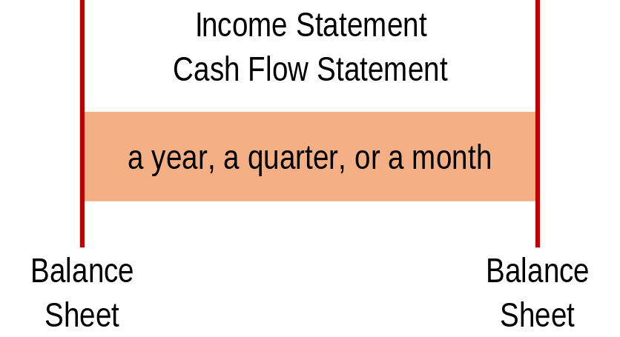
NTE 1010 – Introduction to Finance for Engineers
[2] Financial Statements
Major Financial Statements
  Three major financial statements that form the core of financial accounting:
  Balance Sheet
    shows the accumulated wealth of the business at the end of the period,
  Income Statement (also known as Profit and Loss Account)
    shows the wealth (profit) generated or lost by the business during the period,
  Cash Flow Statement
    shows the cash in and cash out during the period.
  Taken together, they provide an overall picture of the financial health of the business.

Slide 9
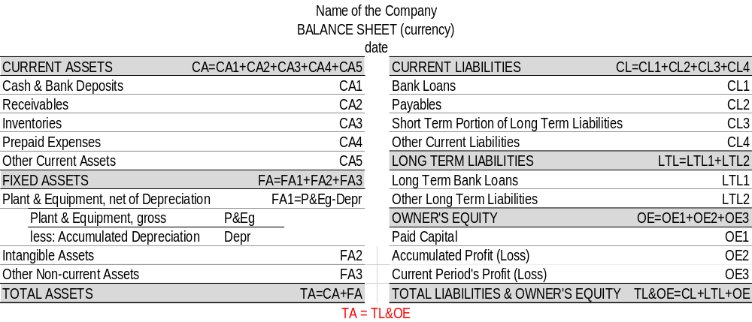
NTE 1010 – Introduction to Finance for Engineers
[2] Financial Statements
Balance Sheet
  Basic Structure of a Balance Sheet:
  + Assets (resources held by the business)
  - Liabilities (obligation of the business to provide cash, or some other form of benefit to other individuals and organizations apart from the owners)
  = Owner’s Equity (accumulated wealth of the business)

Slide 10
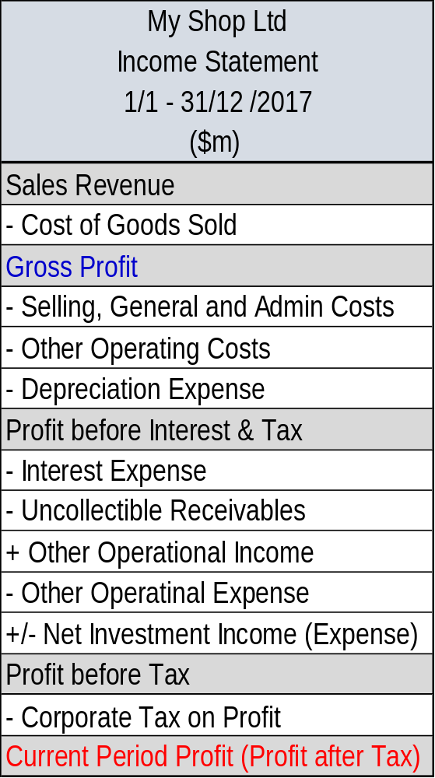
NTE 1010 – Introduction to Finance for Engineers
[2] Financial Statements
Income Statement
  The purpose of the Income Statement,
  also called Profit and Loss Account,
  is to measure and report how much profit (wealth)
  the business has generated
  over a period
  (most commonly a year, a quarter, a month).

Slide 11
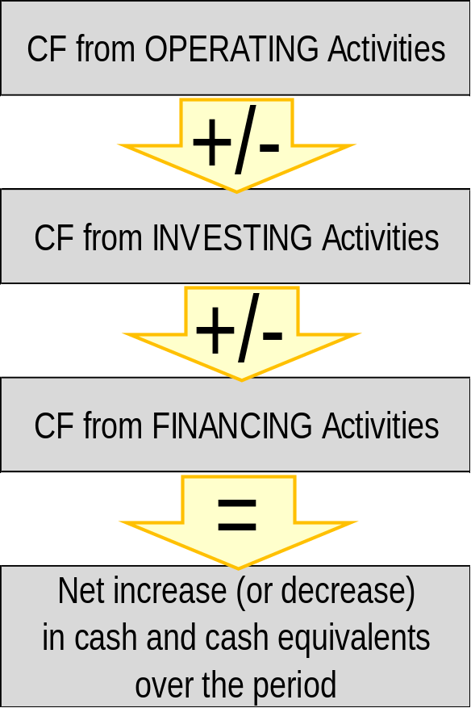
NTE 1010 - Introduction to Finance for Engineers
[2] Financial Statements
Cash Flow Statement
including Profit

Slide 12
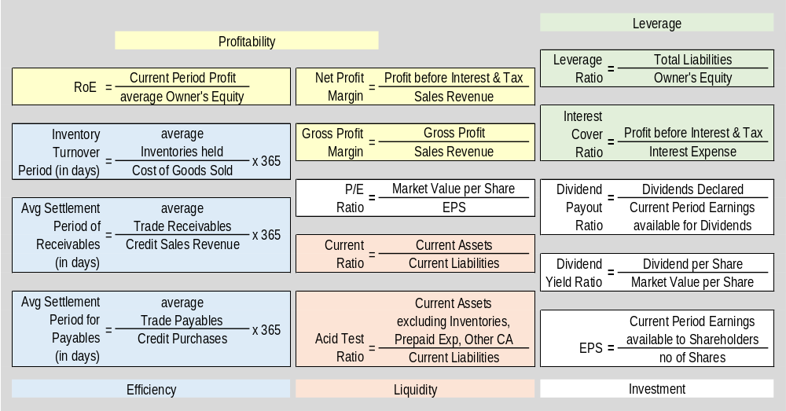
NTE 1010 – Introduction to Finance for Engineers
[3] Analysing & Interpreting Financial Statements
Ratio Analysis

Slide 13
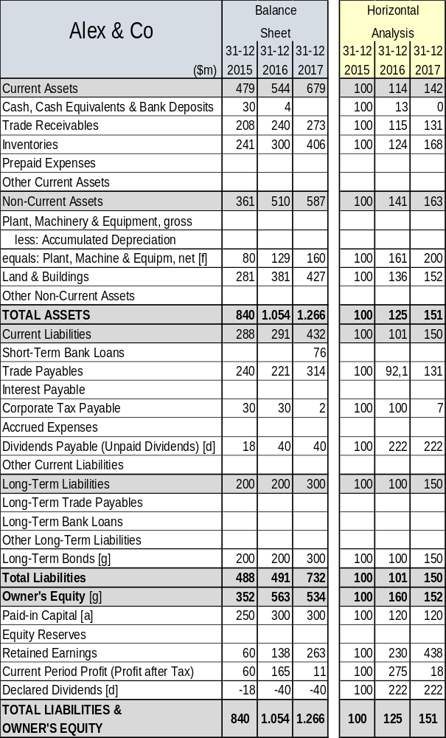
NTE 1010 – Introduction to Finance for Engineers
[3] Analysing & Interpreting Financial Statements
Horizontal Analysis

Slide 14
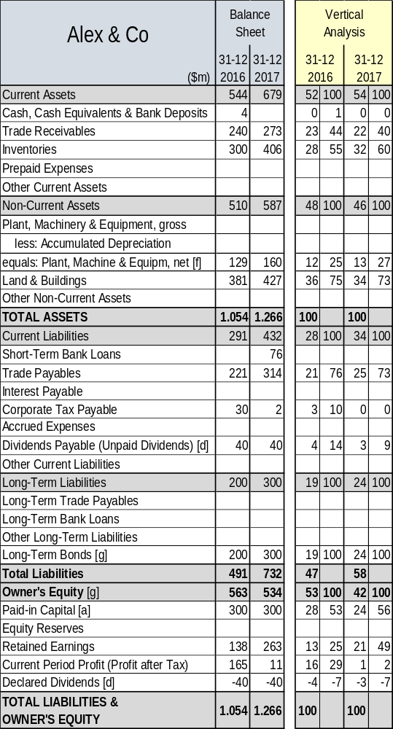
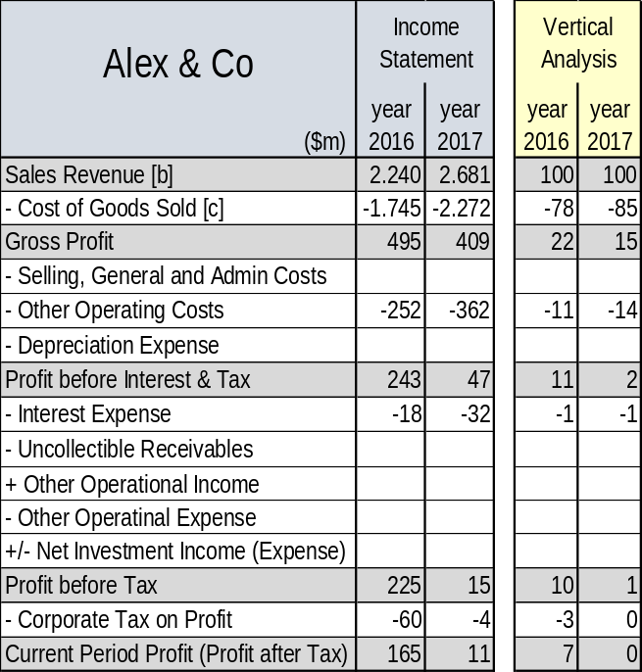
NTE 1010 – Introduction to Finance for Engineers
[3] Analysing & Interpreting Financial Statements
Vertical Analysis

Slide 15
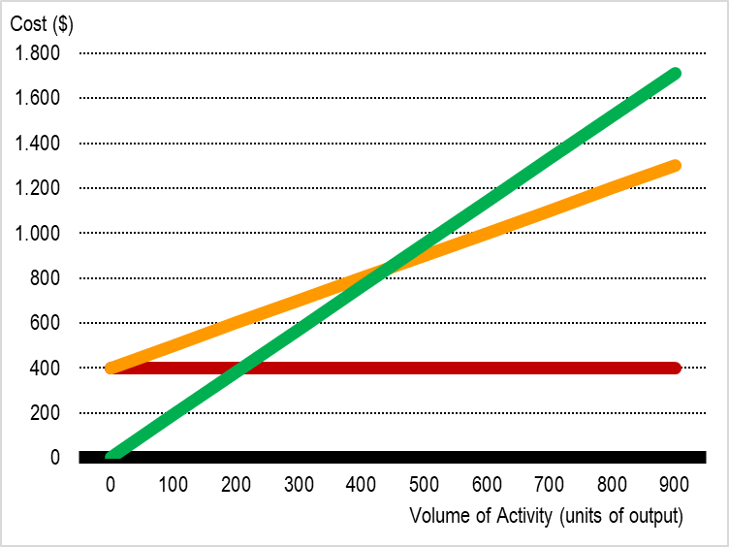


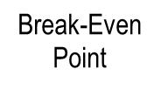


NTE 1010 – Introduction to Finance for Engineers
[4] Management Accounting
Break-Even Analysis
The Break-Even Point (BEP) is
the level of activity (in units of output or sales revenue) at which
Total Costs (fixed & variable) = Total Sales Revenue.
BEP = Fixed Costs / (Price – Unit Variable Costs)

Slide 16
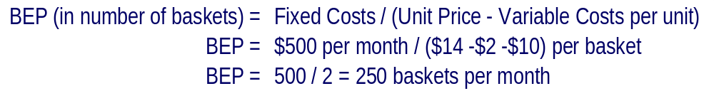
NTE 1010 – Introduction to Finance for Engineers
[4] Management Accounting
Break-Even Analysis
Cottage Industries Ltd makes baskets.
The fixed costs of operating the workshop for a month total $500.
Each basket requires materials that cost $2.
Each basket takes one hour to make, and the business pays the basket makers $10 an hour.
The basket makers are all on contracts such that
if they do not work for any reason, they are not paid.
The baskets are sold to a wholesaler for $14 each.
What is the Break-Even Point (BEP) for basket making for the business?

Slide 17
NTE 1010 – Introduction to Finance for Engineers
[4] Management Accounting
Margin of Safety
Margin of Safety = excess of planned volume of activity over BEP / planned volume of activity
Margin of Safety = (600-420) / 600 = 30%
420

Slide 18
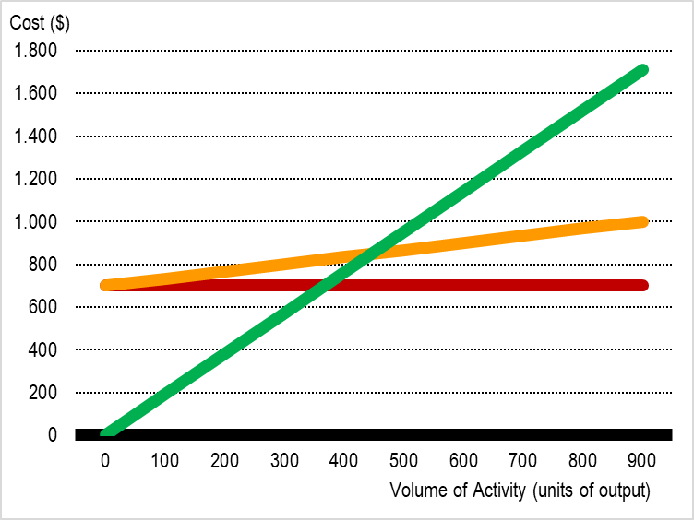


NTE 1010 – Introduction to Finance for Engineers
[4] Management Accounting
Operating Gearing
Operating Gearing = the extent to which the total costs of some activity are fixed rather than variable.
An activity with relatively high fixed costs compared with its variable costs
is said to have higher operating gearing.
higher operating gearing
Loss

Slide 19
NTE 1010 – Introduction to Finance for Engineers
[4] Management Accounting
Activity-Based Costing
Modern Producers Ltd runs, like virtually all manufacturers, finished goods stores.
The business has two product lines, A and B.
Product A tends to be made in small batches and so low levels of finished goods inventories are held.
Product B is supllied in relatively large quantities instantly. As a consequence,
much of the finished goods stores is filled with Product B ready to be dispatched as an order is received.
Traditionally, the cost of of operationg the stores (an overhead cost) are allocated to products A and B
according to the number of direct labour hours worked on each one.
And, that did not seem fair to the new accountant Modern Producers Ltd.
He estimated that the costs of running the finished goods stores for the next year will be 90,000$.
It is also estimated that each unit of Product A will spend an average of 1 week in the stores before being sold.
With Product B, the equivalent period is 4 weeks.
Both products are of roughly similar size and have very similar storage needs.
It is estimated that next year 50,000 units of Product A and 25,000 units of Product B will pass through the stores.
The new accountant wants to allocate the overhead cost of running the finished goods stores to products A and B
according to Activity-Based Costing
with the quantity of products and the time spent in the stores as the cost drivers.

Slide 20
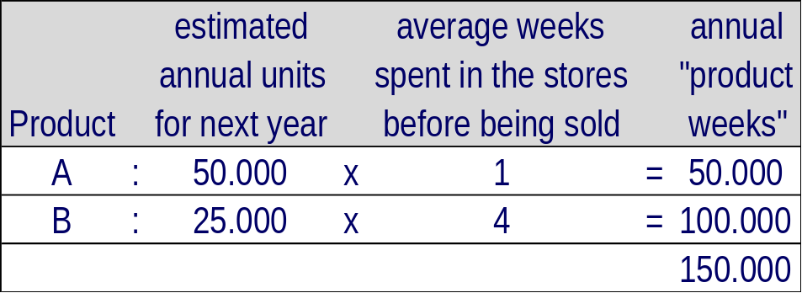
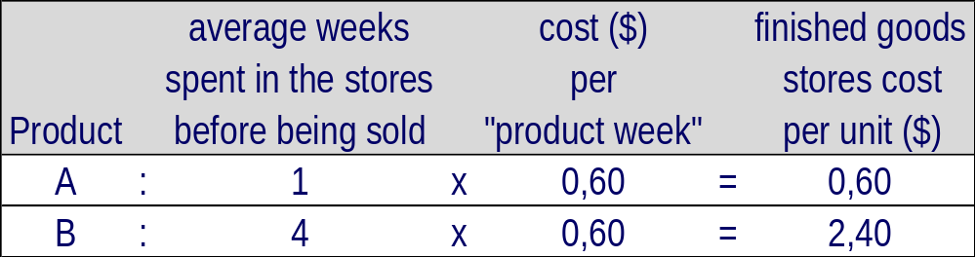
NTE 1010 – Introduction to Finance for Engineers
[4] Management Accounting
Activity-Based Costing
The total number of "product weeks" in the stores will be:
The finished goods store cost per "product week" is given by 90,000$ / 150,000 product weeks = 0.60$
Therefore each unit of product A and product B will be charged as follows:

Slide 21
NTE 1010 – Introduction to Finance for Engineers
[4] Management Accounting
Budgeting
  Budget = a short-term business plan, mainly expressed in financial terms.
  Budgets are the short-term means of working towards the business's objectives.
  They are usually prepared for 12 months with subperiods of a month.
  Uses are to:
    promote forward thinking
    help coordinate the various aspects
    motivate performance
    provide the basis of a system of control
    provide a system for authorisation

Slide 22
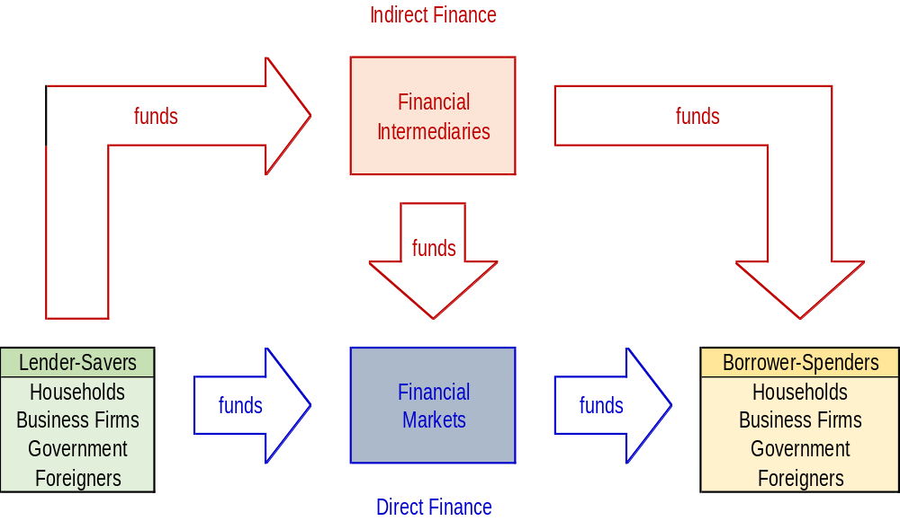
NTE 1010 – Introduction to Finance for Engineers
[5] Financial System
Flow of Funds through the Financial System
In Indirect Finance, borrowers borrow funds directly from Lenders in Financial Markets
by selling them securities (financial instruments)
which are claims on the borrower’s future income or assets.
Financial markets perform the essential economic function of channeling funds
from households, firms, and governments
that have saved surplus funds by spending less than their income
to those that have a shortage of funds because they wish to spend more than their income.

Slide 23
NTE 1010 – Introduction to Finance for Engineers
[5] Financial System
Primary and Secondary Markets
Primary Market
is a financial market in which new issues of a Financial Security, such as a bond or stock,
are sold to initial buyers by the corporation or the government agency borrowing the funds.
Secondary Market
is a financial market in which securities that have been previously issued can be resold.
An important financial institution that assists in the initial sale of securities in the primary market
is the investment bank. It does this by underwriting securities:
It guarantees a price for a corporation’s securities and then sells them to the public.
Securities brokers and dealers are crucial to a well-functioning secondary market.
Brokers are agents of investors who match buyers with sellers of securities;
dealers link buyers and sellers by buying and selling securities at stated prices.
Secondary markets serve two important functions:
First, they make it easier and quicker to sell financial instruments;
that is, they make the financial instruments more liquid.
Second, they determine the price of the security that the issuing firm sells in the primary market.
  Secondary markets can be organized in two ways:
  One method is to organize Exchanges, where buyers and sellers of securities
  (or their agents or brokers) meet in one central location to conduct trades.
  The other is to have an Over-the-Counter (OTC) market,
  in which dealers at different locations who have an inventory of securities stand ready
  to buy and sell securities ″over the counter″ to anyone who comes to them and is willing to accept their prices.

Slide 24
NTE 1010.1 – Introduction to Finance for Engineers
[5] Financial System
Equity
  1. Ordinary Shares:
  The investors provide the share capital for partial ownership of the business.
  The return to the holders of ordinary shares is directly related to the performance of the business in two forms;
            The growth in the value of the company,
            The dividends paid by the company.
The holders of ordinary shares are exposed to the entire risk of the business.
If the company sells new shares to existing shareholders
who have pre-emptive right to subscribe to new shares, it is called a rights offer.
Current shareholders may also waive their right to subscribe to new shares.
In such a case, the company can raise equity capital
by selling new shares to new shareholders for cash; this called follow-on offer.
2. Preferred stock
Preferred Stock has the characteristics of both equity and debt.
Dividend offered by Preferred Stock is fixed, a percent of the face value of the shares.
These payments are similar to the interest payments on debt.
However, if there are insufficient funds, no payments are made
and this does not throw the company into bancruptcy.
Usually, these unpaid dividends accumulate and holders of Preferred Stock are paid in arrears.
Preference shares usually have no maturity date.
Unlike debt, the dividend payment to Preferred Stock is not tax-deductible.
In case of liquidation of the company,
the holders of Preferred Stock have a claim to to the assets prior to that of the ordinary shareholders.

Slide 25
NTE 1010 – Introduction to Finance for Engineers
[5] Financial System
Types of Financial Intermediaries
Banks accept deposits from individuals and institutions and make loans.
Life Insurance / Pension Companies insure people
against financial hazards following a death
and sell annuities (annual income payments upon retirement).
They acquire funds from the premiums that people pay to keep their policies in force
and use them to invest in financial markets.
Mutual Funds acquire funds by selling their own shares to many individuals
and use the proceeds to purchase diversified portfolios of stocks and bonds.

Slide 26
NTE 1010 – Introduction to Finance for Engineers
[5] Financial System
Money
  Primary Functions of Money:
  Money in the form of currency, checks or electronic cards is a Medium of Exchange;
  it is used to pay for goods and services.
  Money provides a Unit of Account;
  it is used to measure value in the economy.
  Money also functions as a Store of Value;
  it is a repository of purchasing power over time.
  There are expanding levels of
  money supply measurement:
  M0 = physical money
  (paper, coin, deposits of banks at Central Bank which the Central Bank has to provide cash on demand)
  M1 = M0 +current deposits
  M2 = M1 +deposits with maturity of less than 30 days
  M3 = M2 +time deposits

Slide 27
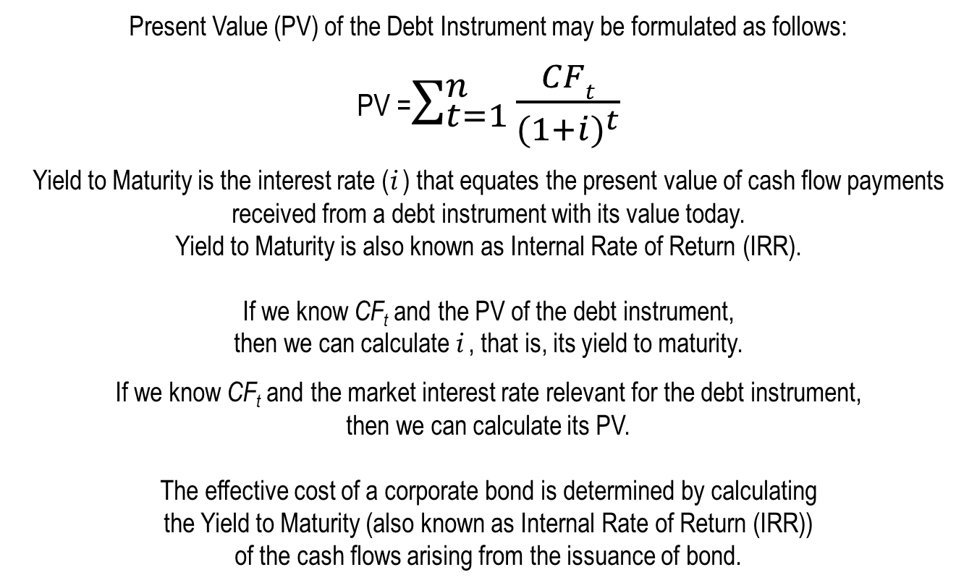
NTE 1010 – Introduction to Finance for Engineers
[6] Interest Rates
Yield to Maturity
Present Value (PV) of the Debt Instrument may be formulated as follows:
PV =$\sum_{t=1}^{n}{\frac{CFt}{{(1+i)}^{t}}}$
Yield to Maturity is the interest rate (i ) that equates the present value of cash flow payments received from a debt instrument with its value today.
Yield to Maturity is also known as Internal Rate of Return (IRR).
If we know CF_{t} and the PV of the debt instrument,
then we can calculate i , that is, its yield to maturity.
If we know CF_{t} and the market interest rate relevant for the debt instrument,
then we can calculate its PV.
  The effective cost of a corporate bond is determined by calculating
  the Yield to Maturity (also known as Internal Rate of Return (IRR))
  of the cash flows arising from the issuance of bond.

Slide 28
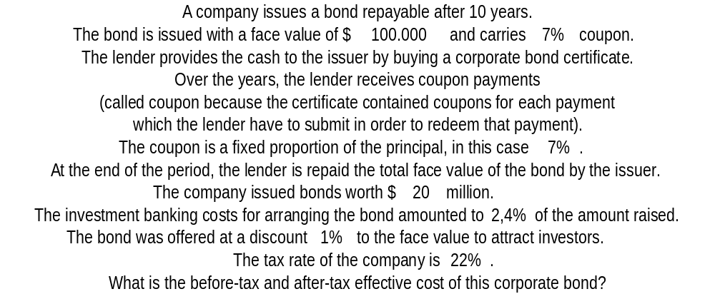
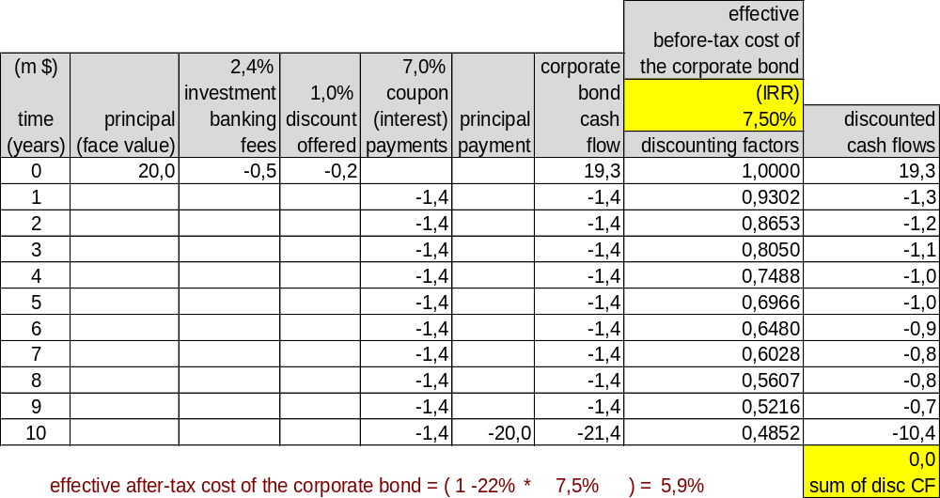
NTE 1010 – Introduction to Finance for Engineers
[6] Interest Rates
Effective Cost of a Corporate Bond

Slide 29
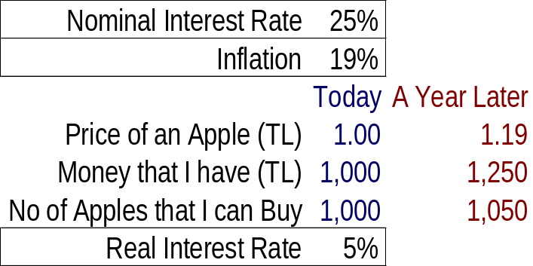
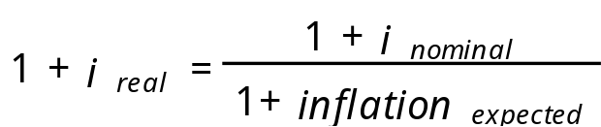
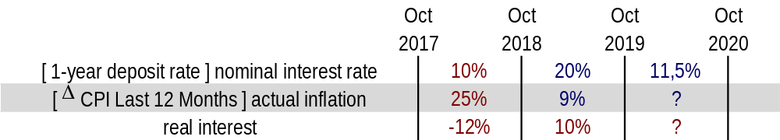
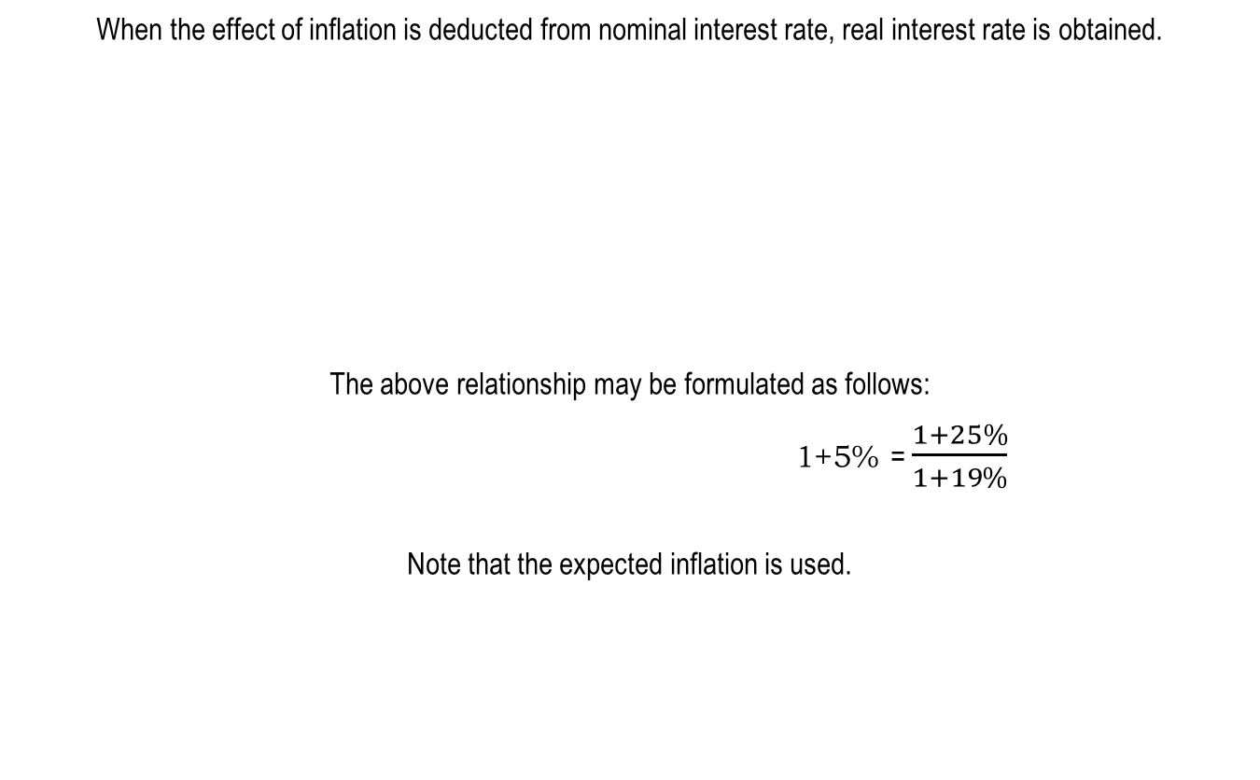
NTE 1010 – Introduction to Finance for Engineers
[6] Interest Rates
Real versus Nominal Interest Rate
When the effect of inflation is deducted from nominal interest rate, real interest rate is obtained.
The above relationship may be formulated as follows:
                1+5% = $\frac{1+25\%}{1+19\%}$
Note that the expected inflation is used.

Slide 30
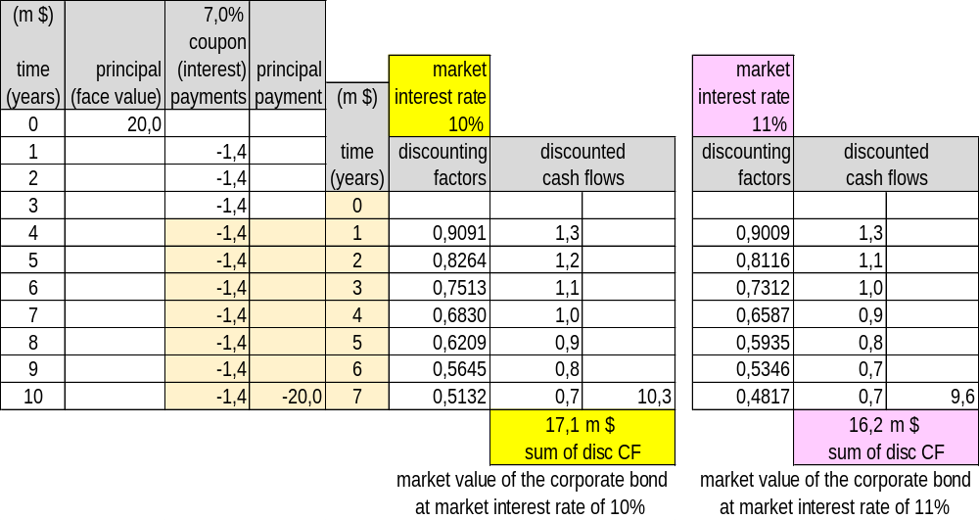
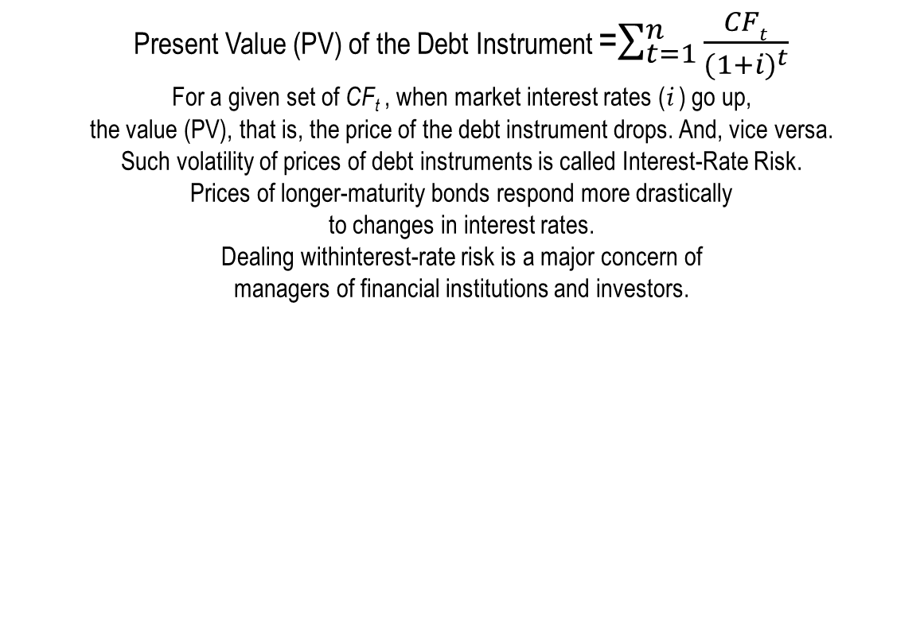
NTE 1010 – Introduction to Finance for Engineers
[6] Interest Rates
Interest-Rate Risk
Present Value (PV) of the Debt Instrument =$\sum_{t=1}^{n}{\frac{CFt}{{(1+i)}^{t}}}$
For a given set of CF_{t} , when market interest rates (i ) go up,
the value (PV), that is, the price of the debt instrument drops. And, vice versa.
Such volatility of prices of debt instruments is called Interest-Rate Risk.
Prices of longer-maturity bonds respond more drastically
to changes in interest rates.
Dealing withinterest-rate risk is a major concern of
managers of financial institutions and investors.

Slide 31
NTE 1010 – Introduction to Finance for Engineers
[6] Interest Rates
Yield Curve
A plot of the yields on bonds with differing terms to maturity
but the same risk, liquidity, and tax considerations is called a yield curve,
and it describes the term structure of interest rates for particular types of bonds.
Three empirical facts about term structure of interest rates are:
  Interest rates on bonds of different maturities move together over time.
  When short-term interest rates are low, yield curves are more likely
        to have an upward slope;
      when short-term interest rates are high,
          yield curves are more likely to slope downward (i.e. inverted).
  Yield curves almost always slope upward.
Three theories have been put forward to explain the term structure of interest rates,
i.e. shapes of yield curves:
            The Expectations theory
            The Segmented Markets theory
            The Liquidity Premium theory

Slide 32
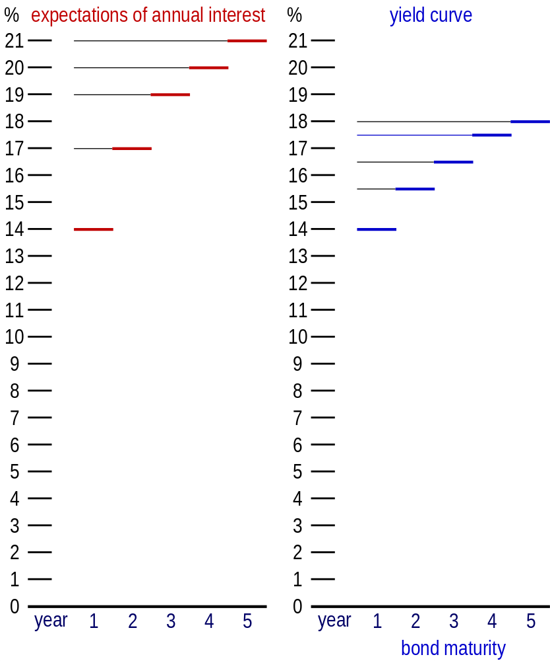
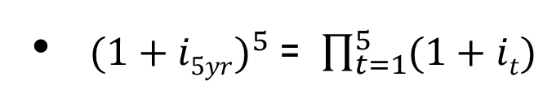
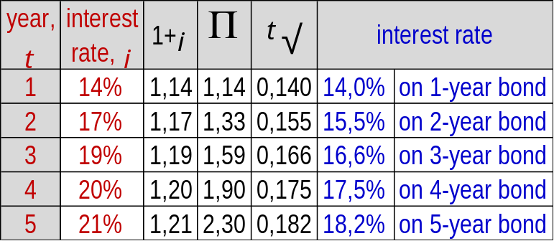
NTE 1010 – Introduction to Finance for Engineers
[6] Interest Rates
Expectations Theory
″The interest rate on a long-term bond will equal
an average of the short-term interest rates
that people expect to ocur
over the life of the long-term bond.″
For a 5-year bond,
the yield formulation would be as follows:
When the yield curve is upward-sloping,
the expectations theory suggests that
short-term interest rates are expected
to rise in the future.
If expectation of annual interest rates
for the next 5 years is as follows,
what would be the yield curve
according to the expectations theory?

Slide 33
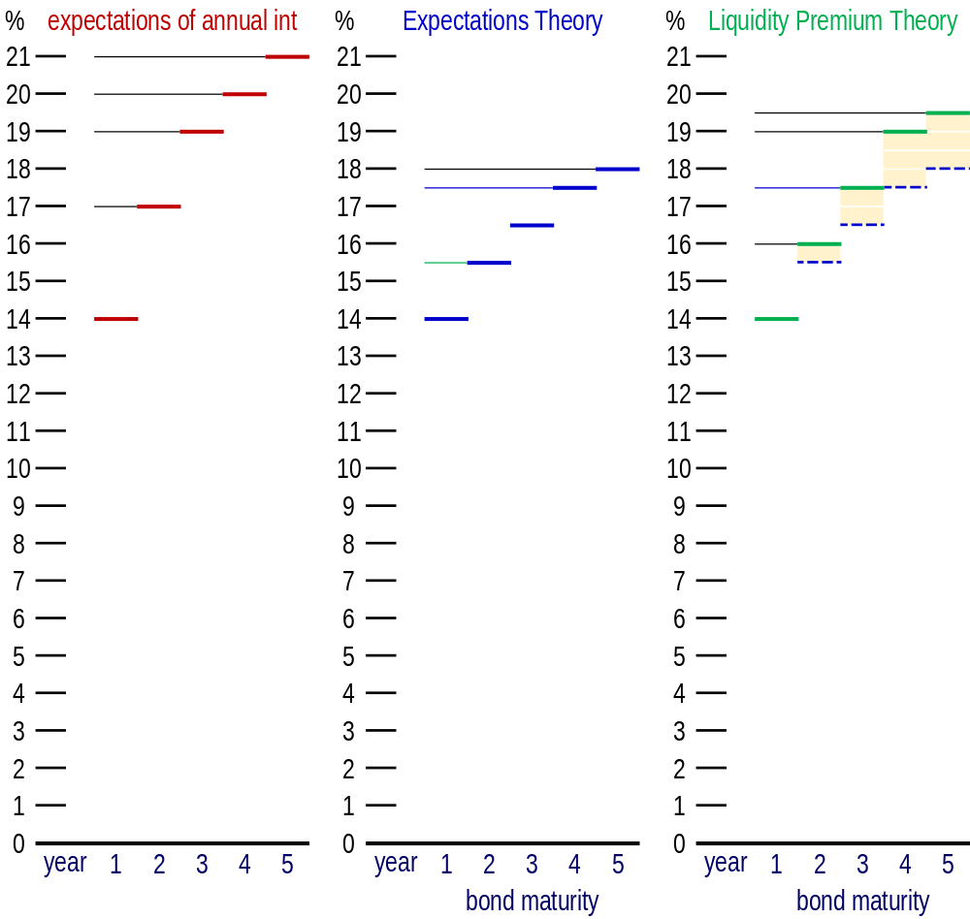
NTE 1010 – Introduction to Finance for Engineers
[6] Interest Rates
Liquidity Premium Theory
Because
the liquidity premium
is always positive
and grows
as the term to maturity
increases,
the yield curve implied by the liquidity premium theory
is always above
the yield curve implied by the expectations theory and
has a steeper slope.

Slide 34
NTE 1010 – Introduction to Finance for Engineers
[7] Stock Markets
Computing the Price of Common Stock
Common stock is the principal way that corporations raise equity capital.
Stockholders – those who hold stock in a Corporation –
own an interest in the Corporation proportional to the percentage outstanding shares they own.
This ownership interest gives them the right to vote
and to be the residual claimant of all funds flowing into the firm (known as cash flows),
meaning that the stockholder receives whatever remains
after all other claims against the firm’s assets have been satisfied.
Stockholders may receive dividends from the net earnings of the Corporation.
Dividends are payments made periodically,
usually every quarter in the U.S. and annually in Turkey, to stockholders.
In addition, the stocholder has the right to sell the stock.
One basic principle of finance is that the value of any investment is found by computing
the present value of all cash flows the investment will generate over its life.
The cash flows a stockholder might earn from stock are dividends, the sales price, or both.

Slide 35
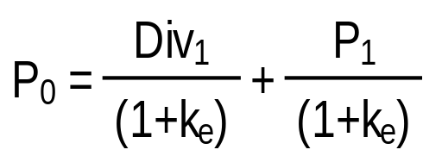
NTE 1010 – Introduction to Finance for Engineers
[7] Stock Markets
The One-Period Valuation Model
To value the stock today,
you need to find the present discounted value of the expected cash flows (future payments).
The cash flows consist of one dividend payment plus a final sales price.
P₀ = the curent price of the stock
(the zero subscript refers to time period zero, or the present)
Div₁ = the dividend paid at the end of year 1
k_{e} = the required return on investments in equity
P₁ = the price at the end of the first year; predicted sales price of the stock

Slide 36
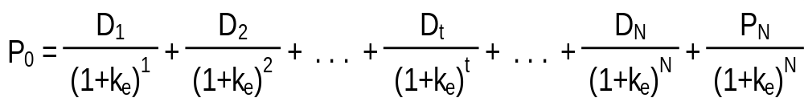
NTE 1010 – Introduction to Finance for Engineers
[7] Stock Markets
The Generalized Dividend Valuation Model
Using the present value concept,
we can extend the one-period dividend valuation model to any number of periods:
The value of a stock today is the present value of all future cash flows.
P₀ = the curent price of the stock
D_{t} = the dividend paid at the end of year t
k_{e} = the required return on investments in equity
P_{N} = the price at the end of year N; predicted sales price of the stock

Slide 37
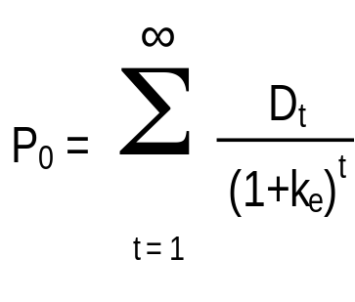
NTE 1010 – Introduction to Finance for Engineers
[7] Stock Markets
The Generalized Dividend Valuation Model
The generalized dividend model may be rewritten without the final sales price.
P₀ = the curent price of the stock
D_{t} = the dividend paid at the end of year t
k_{e} = the required return on investments in equity
This tells us that the price of stock is determined only by the present value of the dividends
and nothing else matters.
In other words, buyers of the stock expect that the firm will pay dividends someday.
Most of the time a firm institutes dividends
as soon as it has completed the rapid growth phase of its life cycle.
However, this model requires that we compute the present value of an infinite stream of dividends,
a process that could be difficult, to say the least.

Slide 38
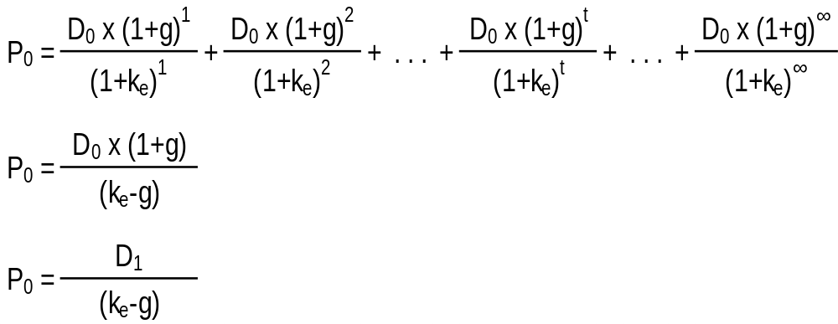
NTE 1010 – Introduction to Finance for Engineers
[7] Stock Markets
Valuation - Gordon Growth Model
The Gordon growth model is a simplified method of computing stock value
that depends on the assumption that the dividends are growing at a constant rate forever.
Given our uncertainty regarding future dividends, this assumption is often the best we can do.
Also, the growth rate is assumed to be less than the required return on equity
which is a reasonable assumption.
P₀ = the curent price of the stock
D₀ = the most recent paid dividend
D₁ = the dividend expected to be paid at the end of year 1
g = the expected average constant growth rate in dividends
k_{e} = the required return on investments in equity

Slide 39
NTE 1010 – Introduction to Finance for Engineers
[8] Financial Crises
2007-2008 Crisis
It began in 2007 with a crisis in the subprime mortgage market in the United States,
and developed into a full-blown international banking crisis
with the collapse of the investment bank Lehman Brothers on September 15, 2008.
Excessive risk-taking by banks such as Lehman Brothers
helped to magnify the financial impact globally.
Massive bail-outs of financial institutions
and other palliative monetary (″quantitative easing″)
and fiscal policies
were employed to prevent a possible collapse of the world financial system.
The crisis was nonetheless followed by a global economic downturn, the Great Recession.
The Europen debt crisis,
a crisis in the banking system of the European countries using the euro, followed later.

Slide 40
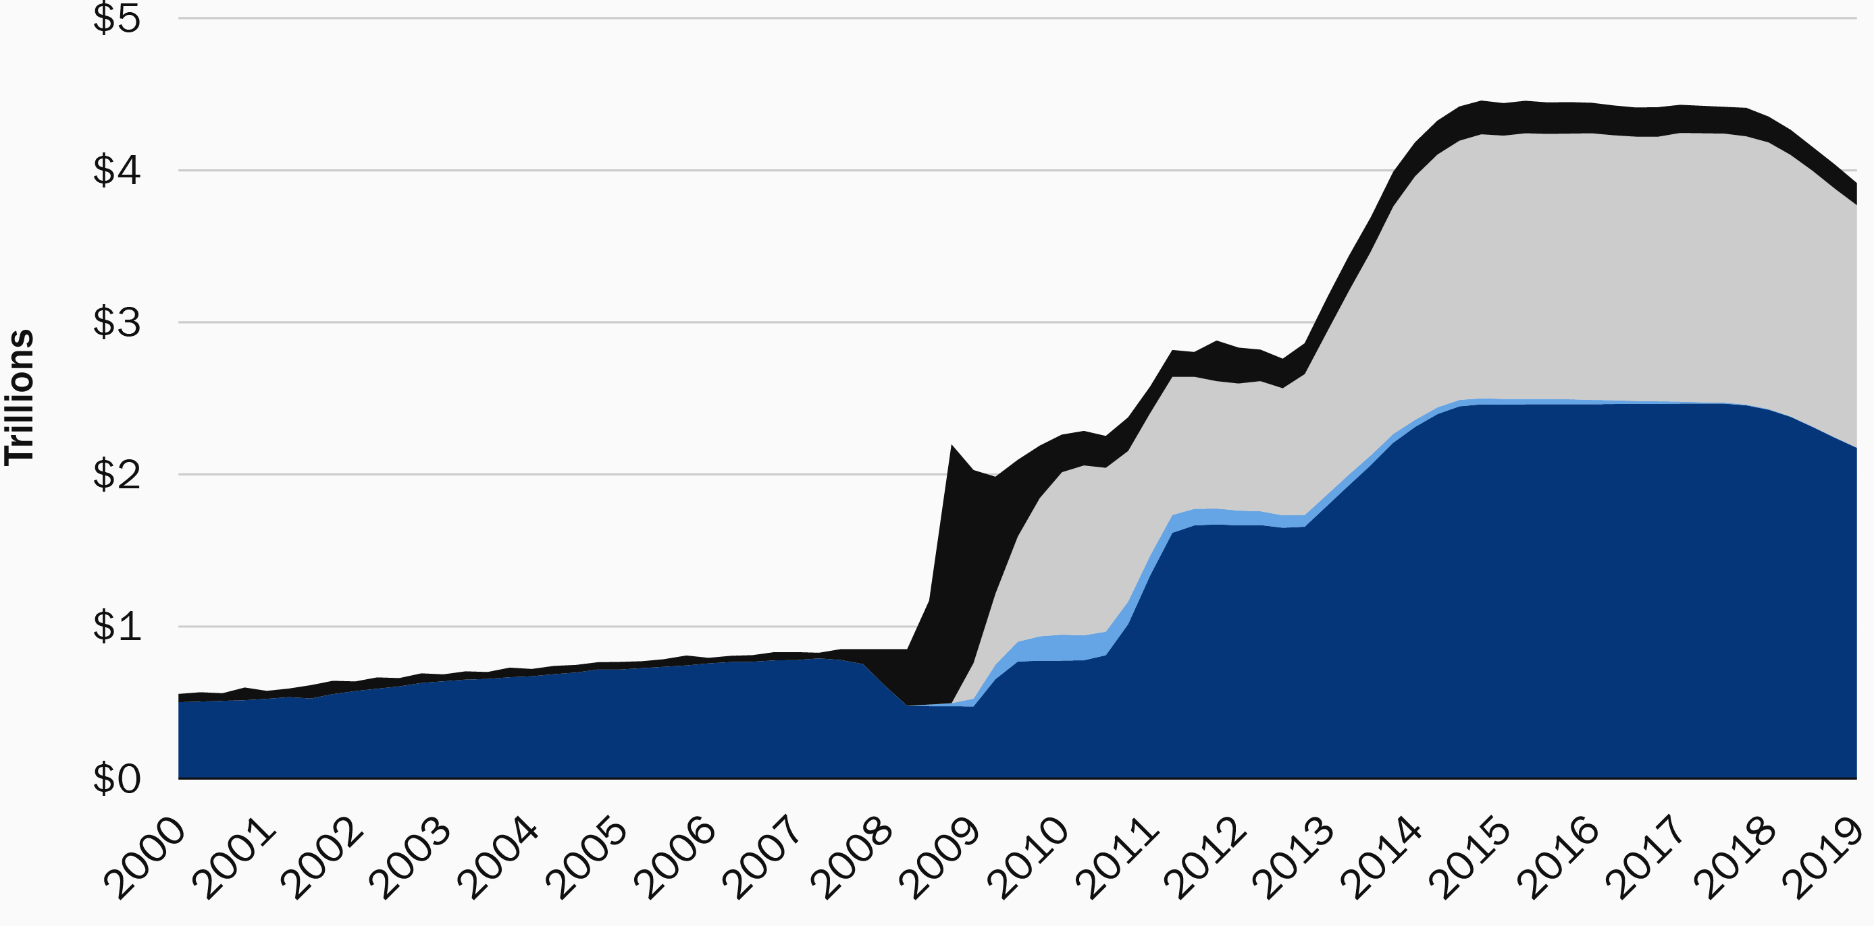
NTE 1010 – Introduction to Finance for Engineers
[8] Financial Crises
2007-2008 Crisis
Quantitative Easing
Quantitative easing (QE) is a monetary policy, implemented by the Central Bank,
primarily to energize the economy.
The Central Bank will create money to buy government securities from the market
in order to lower interest rates and increase the money supply.
These economic conditions will then trigger financial institutions
to promote increased lending and to make money supply more liquid.
FED’s Balance Sheet size
QE2
QE3
QE1

Slide 41
NTE 1010 – Introduction to Finance for Engineers
[9] Banks
Asset Transformation
Banks make profits through the process of asset transformation:
They borrow short (accept short-term deposits)
and lend long (make long-term loans).
Primary concerns of Bank Management:
To make sure that the bank has enough ready cash to pay its depositors
when there are deposit outflows
the bank must engage in Liquidity Management.
Pursuing an acceptably low level of risk
by acquiring assets that have a low rate default
and by diversifying asset holdings (Asset Management).
Acquring funds at low cost (Liability Management).
Deciding the amount of capital the bank should maintain
and then acquiring the needed capital (Capital Adequacy Management).

Slide 42
NTE 1010 – Introduction to Finance for Engineers
[9] Banks
Primary risks in banking
are as follows.
Credit Risk
The risk arising because borrowers may default.
Interest-rate Risk
The riskiness of earnings and returns on bank assets
that results from interest-rate changes.
Credit risk management principles
involving loan activities are the following:
            screening and monitoring
            long-term customer relationships
            loan commitments
            collateral and compensating balances
            credit rationing

Slide 43
NTE 1010 – Introduction to Finance for Engineers
[9] Banks
Estimating the Size of the Interest-Rate Risk
Gap and duration analyses tell a financial institution
if it has more rate-sensitive liabilities than assets
[″rate-sensitive″ = with interest rates that change frequently (at least once a year)
″fixed-rate″ = with interest rates that remain unchanged for a long period (over a year)]
in which case a rise in interest rates will reduce profits
and a fall in interest rates will raise profits.
Gap = rate-sensitive Liabilities – rate-sensitive Assets
By multiplying the Gap times change in interest rate,
we can immediately obtain the effect on bank profits.
Duration = the average lifetime of a security’s stream of payments
By multiplying the weighted average duration of a bank’s assets and of its liabilities
times the amount of assets and of liabilities
times change in interest rate,
we can immediately obtain the approximate effect on bank’s total asset value.
Financial institutions manage their interest-rate risk by modifying their balance sheets
but can also use strategies involving financial derivatives.

Slide 44
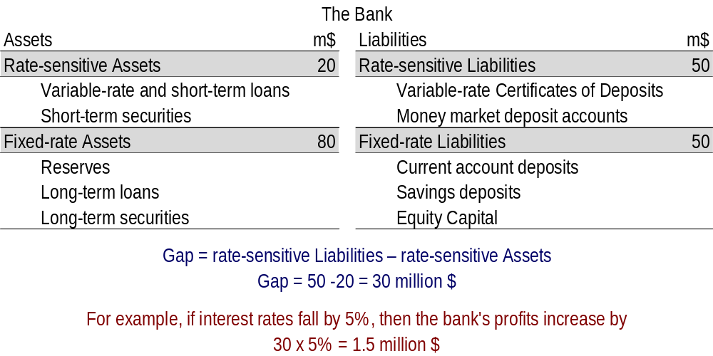
NTE 1010 – Introduction to Finance for Engineers
[9] Banks
Gap Analysis

Slide 45
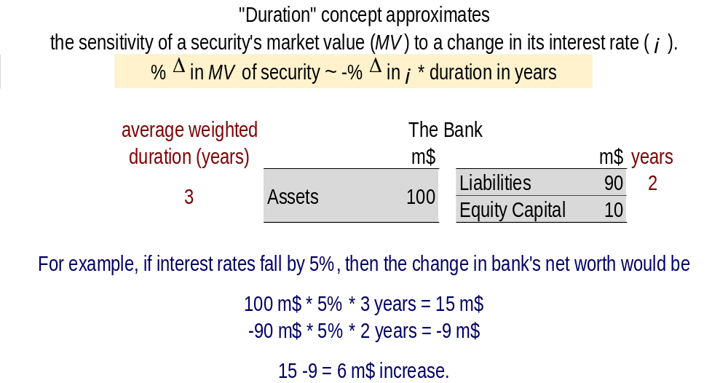
NTE 1010 – Introduction to Finance for Engineers
[9] Banks
Duration Analysis
Duration = the average lifetime of a security’s stream of payments

Slide 46
NTE 1010 – Introduction to Finance for Engineers
[10] Central Banks
Fundamental Powers of Central Bank of Turkey (TCMB)
  exclusive right to issue banknotes in Turkey
  right to determine of the inflation target and implement of monetary policy
  role of the lender of last resort for financial institutions
  power to request information from financial institutions

Slide 47
NTE 1010 – Introduction to Finance for Engineers
[10] Money Supply
Control of the Monetary Base
The primary way in which the Central Bank causes changes in the monetary base
is through its open market operations;
the Central Bank buys/sells bonds from/to banks.
Buying expands MB (=C+R) by increasing reserves of banks held at the Central Bank.
Selling contracts MB.
Lending to financial institutions also expands MB by increasing reserves.
The Central Bank sets the discount rate (interest rate on loans to banks), and then banks make decisions about whether to borrow.
The component of Monetary Base which is created by loans from the Central Bank
(called borrowed reserves)
is less tightly controlled
compared to the component that is created by open market operations
which is called the nonborrowed monetary base.

Slide 48
NTE 1010 – Introduction to Finance for Engineers
[10] Money Supply
Multiple Deposit Creation
When the Central Bank supplies the banking system with 1$ of additional reserves,
deposits increase by a multiple of this amount,
a process called ″multiple deposit creation″.
For example, when the Central Bank buys 100 m$ worth bonds from the First National Bank,
the bank finds that it has an increase in reserves of 100 m$.
Let us say the bank decides to make a loan
equal in amount to the 100 m$ rise in excess reserves.
The borrower deposits the borrowed amount of 100 m$ to Bank A.
If the required reserve ratio is 10%,
Bank A will now find itself with a 10 m$ increase in required reserves,
leaving it 90 m$ of excess reserves which it can lend.
The new borrower deposits the borrowed amount of 90 m$ to Bank B.
Since the required reserve ratio is 10%,
Bank B will now find itself with a 9 m$ increase in required reserves,
leaving it 81 m$ of excess reserves which it can lend.
The process goes on, eventually leading to a 1,000 m$ expansion in deposits.
Δ Deposits = Δ Reserves * Simple Deposit Multiplier
where Simple Deposit Multiplier = 1 / Required Reserve Ratio

Slide 49
NTE 1010 – Introduction to Finance for Engineers
[11] Monetary Policy
Goals
Price stability
High employment and economic growth
Stability of financial markets
Interest-rate stability
Stability in foreign exchange markets

Slide 50
NTE 1010 – Introduction to Finance for Engineers
[12] Foreign Exchange Markets
How Do FX Rates Come Out ?
Law of One Price:
If two countries produce an identical good,
and transportation costs and trade barriers are very low,
the price of the good should be the same throughout the world
no matter which country produces it.
Theory of Purchasing Power Parity (PPP)
states that exchange rates between any two currencies
will adjust to reflect changes in the price levels of the two countries.
The theory of PPP is simply an application of the Law of One Price
to national price levels rather than to individual prices.
Suppose that the Yen price of Japanese steel rises 8% (to 10,800 ¥) due to inflation in Japan
while the Dollar price of the American steel rises 4% (to 104 $) due to inflation in the US;
then 1 $ should be worth 103.85 ¥ reflecting the inflation difference.

Slide 51
NTE 1010 – Introduction to Finance for Engineers
[12] Foreign Exchange Markets
Calculating Forward Rate for Selling FX
[Forward Bid Rate]
Assume 1€ is bought for 6.45 TL and sold for 6.55 TL in the market today
and you ask a bank to quote €/TL rate for 1m € for 3 months from now
when you want to sell your export revenue.
Calculating Forward Rate for Purchasing FX
[Forward Offer Rate]
Assume 1€ is bought for 6.45 TL and sold for 6.55 TL in the market today
and you ask a bank to quote €/TL rate for purchasing 1m € for 3 months from now
when you want to pay for your imports.

Slide 52
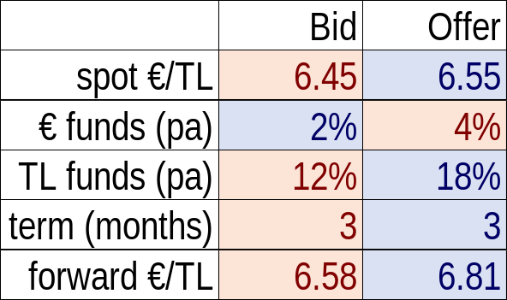
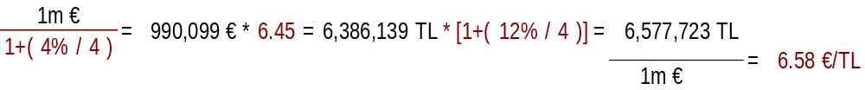
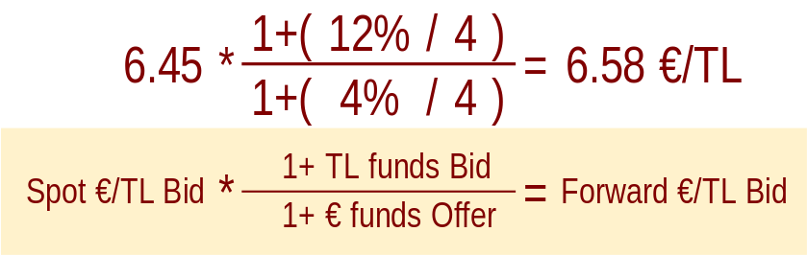
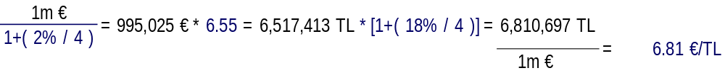

NTE 1010 – Introduction to Finance for Engineers
[12] Foreign Exchange Markets
Calculating Forward FX Rate
Zero transaction costs are assumed.

Slide 53
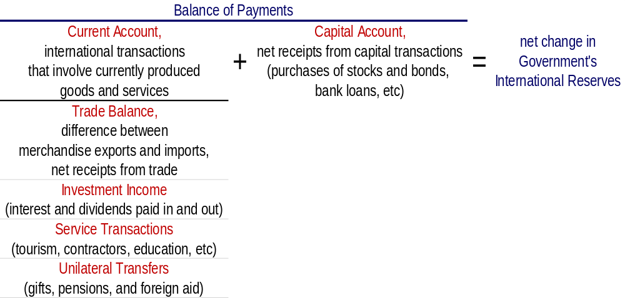
NTE 1010 – Introduction to Finance for Engineers
[13] International Financial System
Balance of Payments
Because the balance of payments must balance, the official transactions balance, which equals the current account plus the capital account, tells us the net amount of international reserves that must move between governments (as represented by their central banks) to finance international transactions.

Slide 54
NTE 1010 – Introduction to Finance for Engineers
[13] International Financial System
Exchange Rate Regimes
Classified into two basic types; «Fixed» and «Floating»,
and a third one which is more or less in between, namely, «Managed Float».
In a fixed exchange rate regime,
the value of a currency is pegged relative to
the value of another currency (called the anchor currency)
so that the exchange rate is fixed in terms of the anchor currency.
In a floating exchange rate regime,
the value of a currency is allowed to fluctuate against all other currencies.
When countries intervene in foreign exchange markets
in an attempt to influence their exchange rates
by buying and selling foreign assets,
the regime is referred to as a managed float regime (or a dirty float).

Slide 55
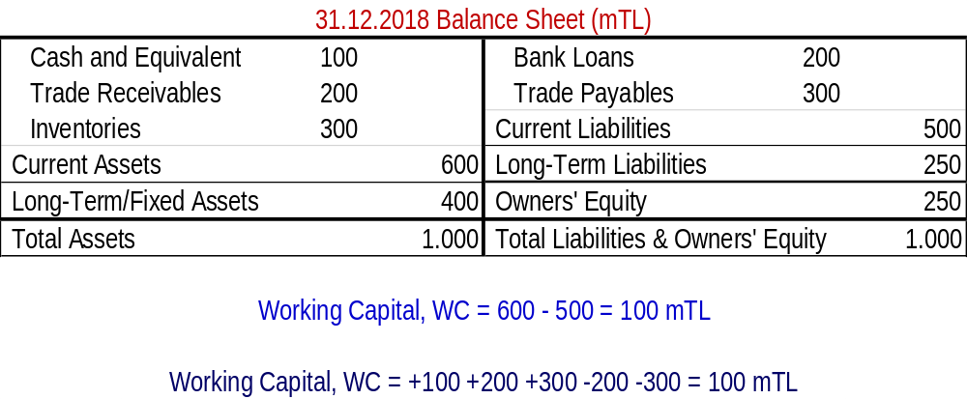
NTE 1010 – Introduction to Finance for Engineers
[14] Managing Working Capital
Working Capital = Current Assets – Current Liabilities
Working Capital = +Cash and Equivalents +Trade Receivables +Inventories
-Bank Loans -Trade Payables

Slide 56
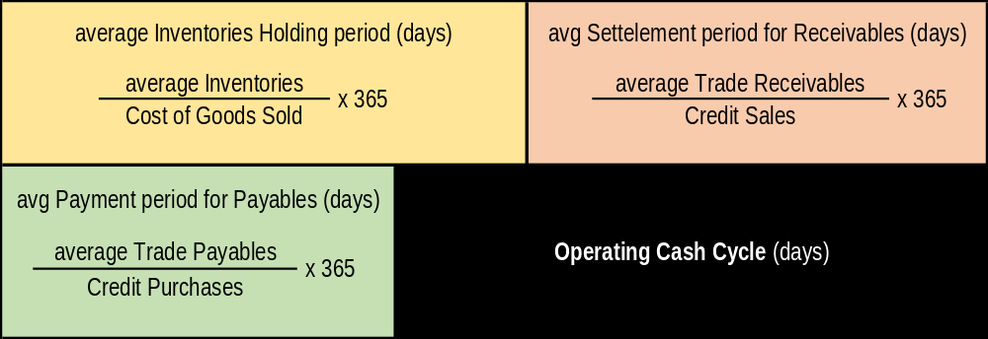
NTE 1010 – Introduction to Finance for Engineers
[14] Managing Working Capital
Measuring Operating Cash Cycle

Slide 57
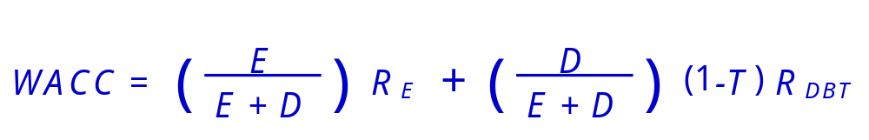
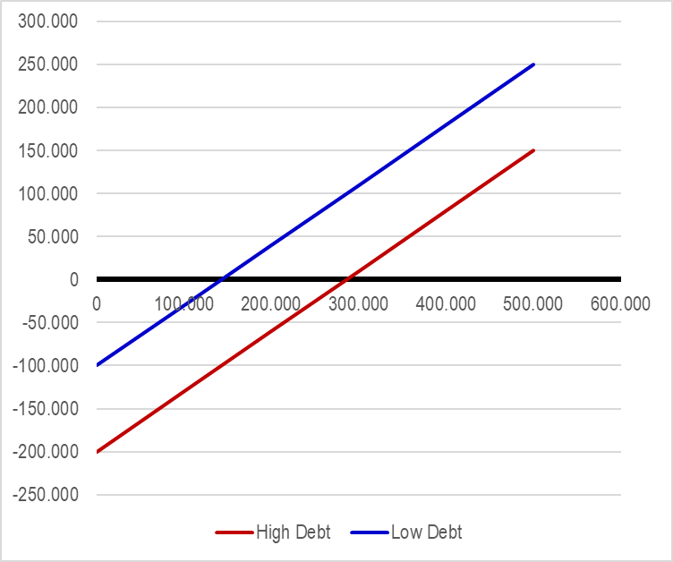
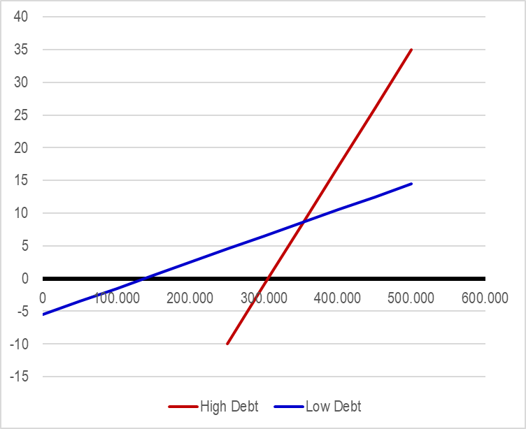
NTE 1010 – Introduction to Finance for Engineers
[14] Managing Working Capital
Weighted Average Cost of Capital, WACC
  An examination of the above equation could lead to the false conclusion that the optimal solution would be to fund the company entirely from debt sources.
  However, increasing debt makes the company more risky
  due to increased fixed costs of servicing (making interest payments of) the debt.
  Investors are often more reluctant to invest in companies that have a high proportion of debt.
  As a result, the cost of equity will increase for companies with an abnormally high proportion of debt.
  Banks would also be more reluctant to lend to such companies.
Earnings, $
Earnings per share, $
Sales, $
additional interest expense
Sales, $

